Slide 1
Original:
Team Shanghai Alice
Notes:
It is an organization created a series of very popular shooting games.

Slide 2

Hakurei Talisman Factory
Notes:
This is a 3D sandbox action game of revolution and uprising. It is also VR compatible. Our game presented here is a fan fiction derived from Team Shanghai Alice works. we do not have to worry character design so we may focus on mechanics. Second, we are able to attract certain fans, which is beneficial to our market performance. Essentially, these characters presented in game can be anyone. Namely John Galt revolt against the incompetent government.

Slide 3

Reimu Hakurei is a greedy capitalist.
Notes:
Talismans meant for peace and blessing turned into weapons in her factory. Uncountable amounts of talismans are printed off the assembly line everyday.

Slide 4

Revolt and make her life miserable!
Notes:
The game is a historical reference to Japanese communism movement after WW2. Thus, relics from that era may be featured in the game as player appearance customization options.

Slide 5
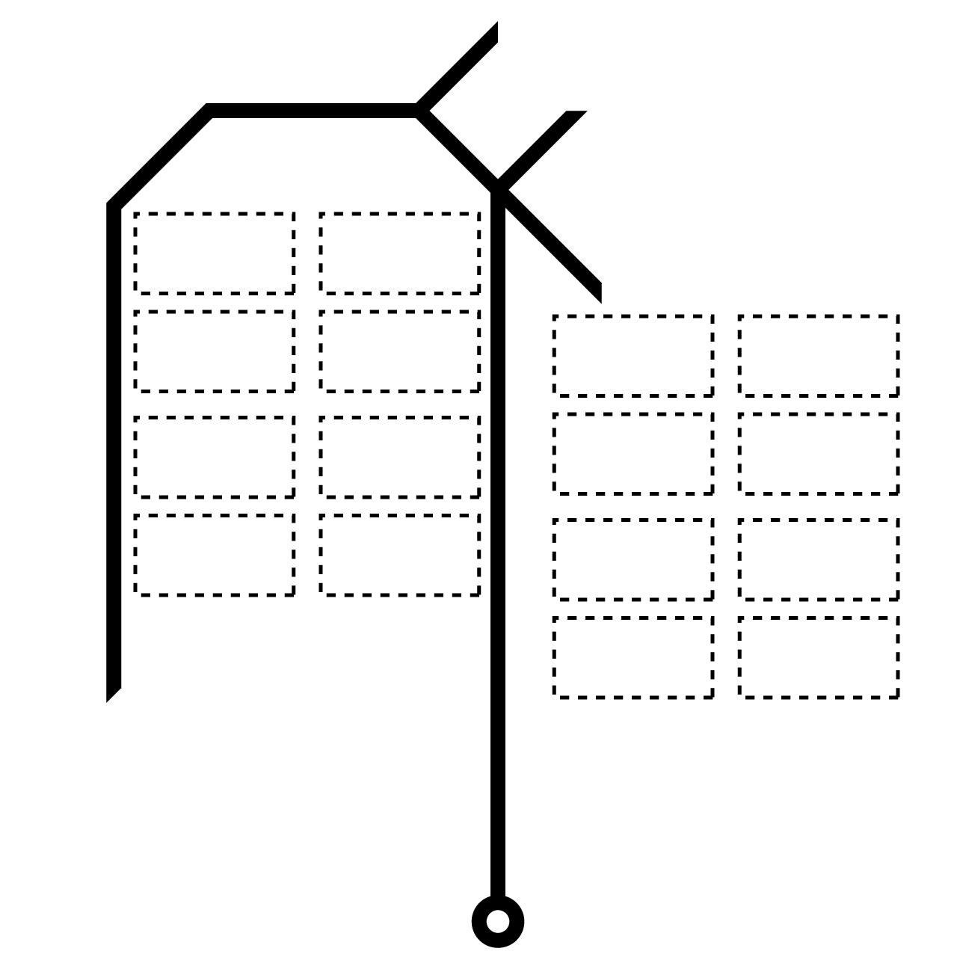
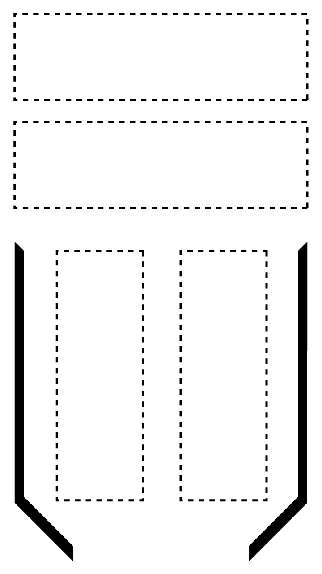
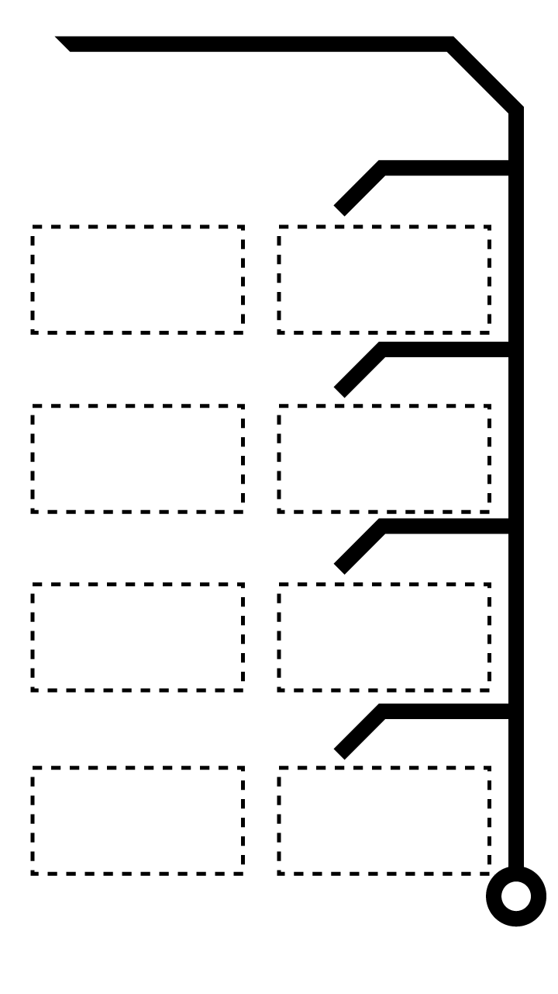
Seize her means of production!
Small Talisman
4 Slots
Medium Talisman
8 Slots
Large Talisman
16 Slots
Notes:
After the narrative background of this game, the gameplay mechanic comes next.
Seize Reimu’s talisman to fight against her! Players can obtain these unfinished talismans from any assembly line in the factory and customize them as weapons.

Slide 6
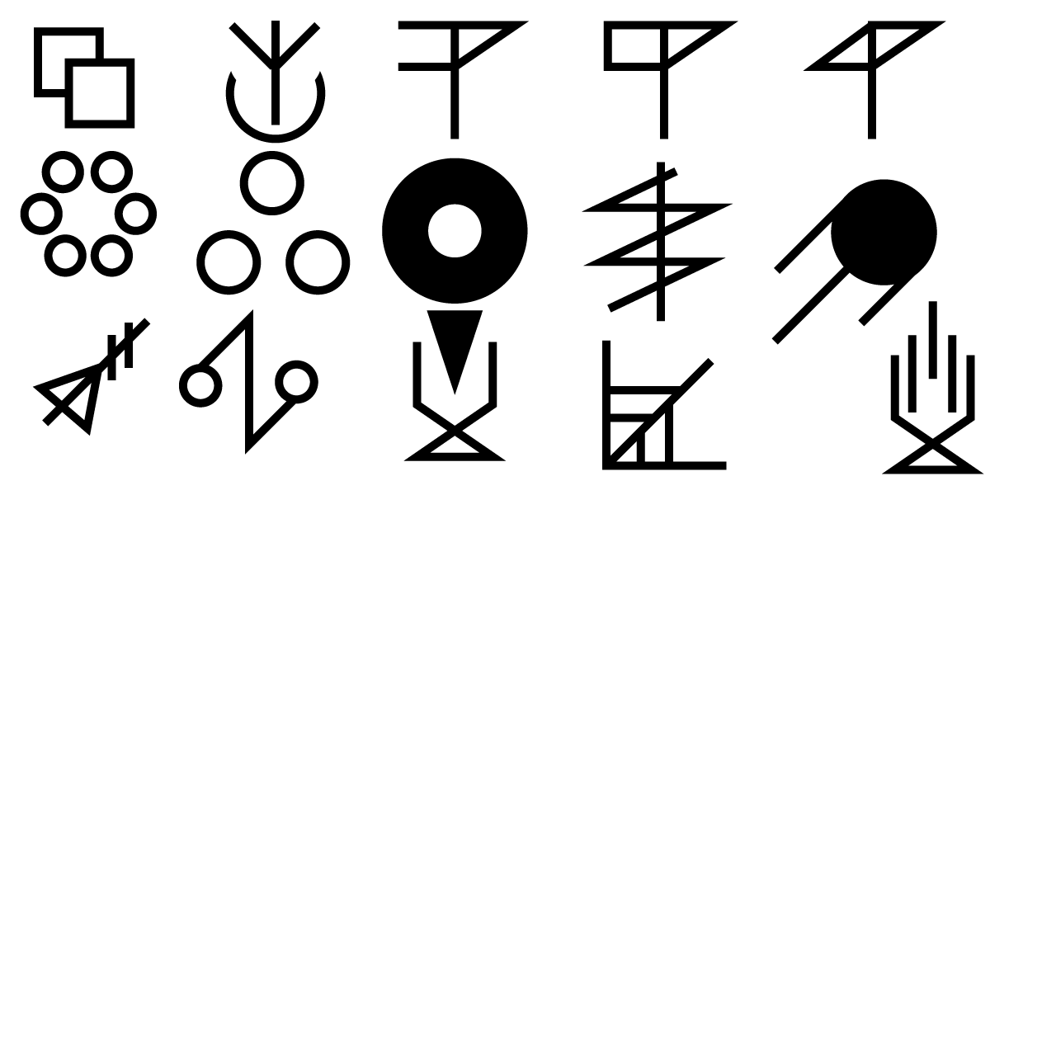
Drag strokes onto your talismans to assign them functions!
Notes:
Similar to talismans, players are able to obtain strokes of diverse function throughout the course of the game. Vast amount of unique “weapons” can be written, contribute a truly creative gaming experience.
For example, pictured strokes are:
Duplicate, scatter, multiply by 5, multiply by 10, multiply by 20;
Small spherical bullet, medium spherical bullet, large spherical bullet, constant beam, fireball bullet;
Pulse beam, bounce, full auto (high RPM high spread), explosive bullet, full auto (low RPM low spread).

Slide 7
Combat experience: flexible ragdoll system.
Notes:
During combat, characters will react to attacks with unique flexible ragdoll system in real time. This system allows both the enemy and player characters to bounce on surface under impact force. In addition, characters will deform back and forth while bouncing, render a comical combat experience.

Slide 8
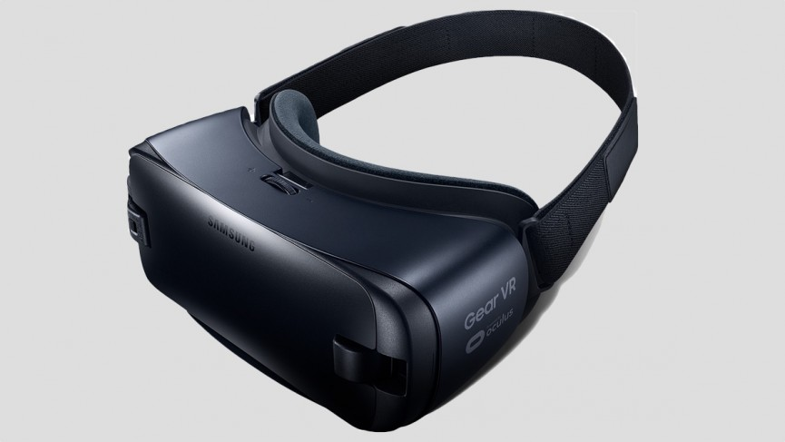
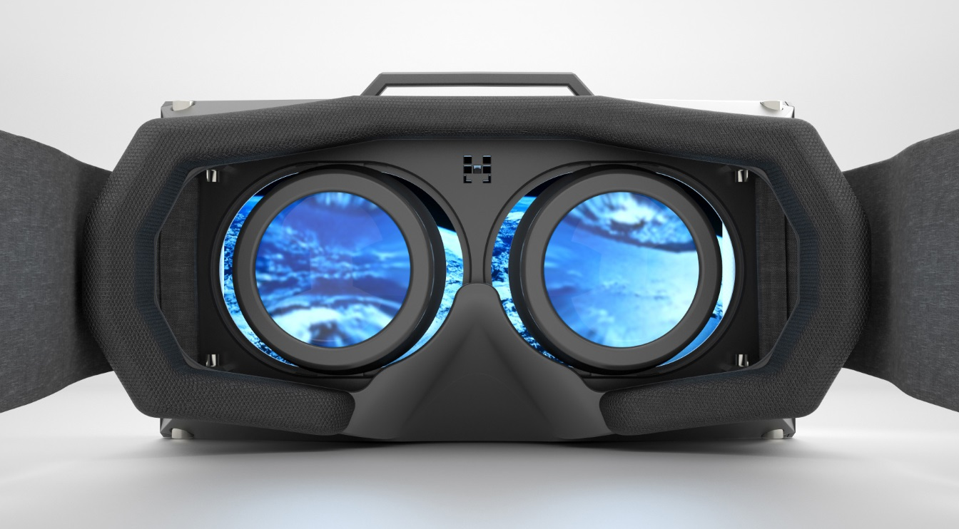
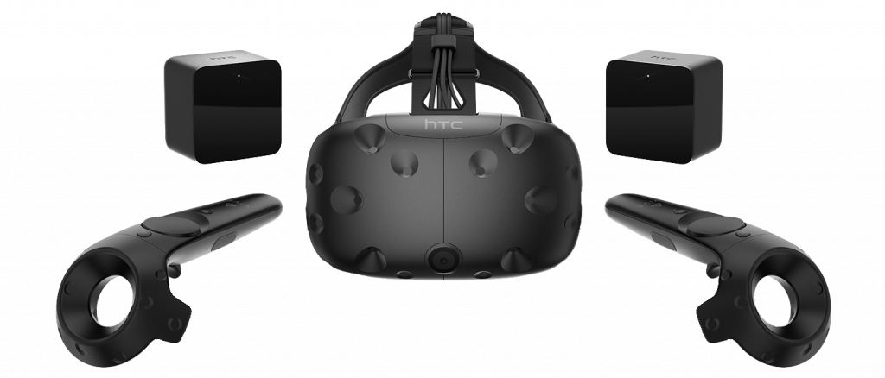
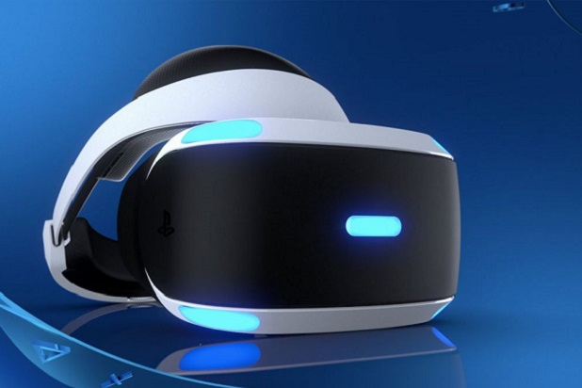
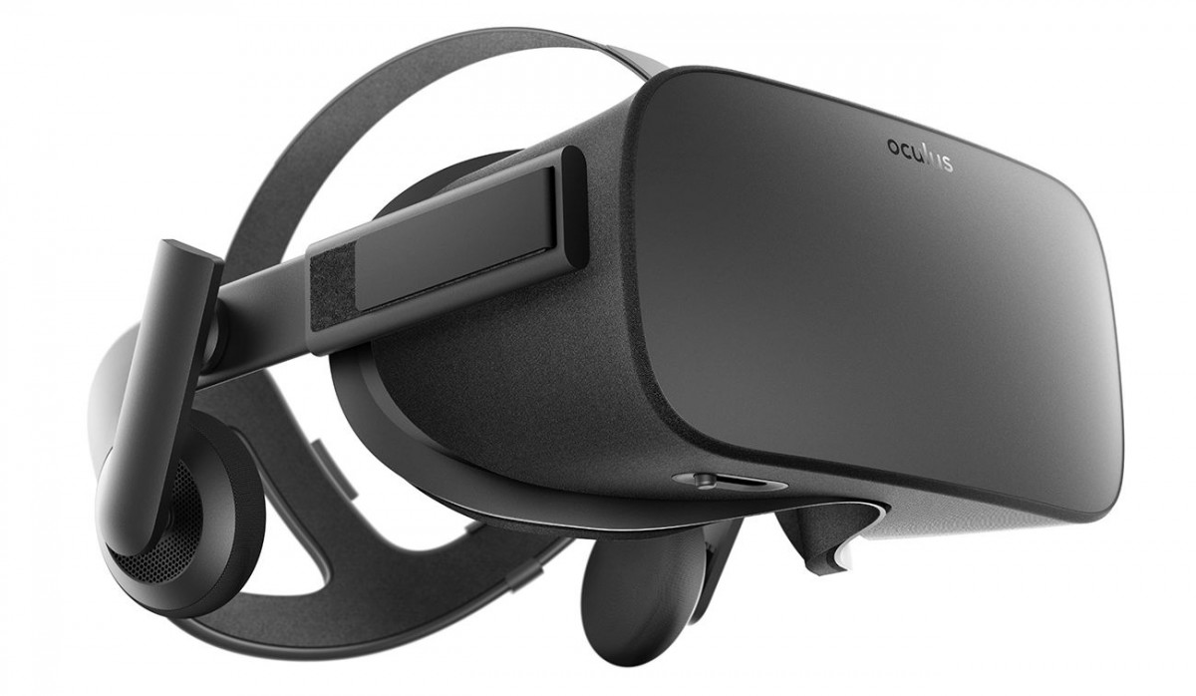
Game Experience – VR Immersion
Notes:
VR is a new platform that becomes more and more popular. There are so many different brands that begin to explore VR and here are some brands that everybody has known about them.

Slide 9
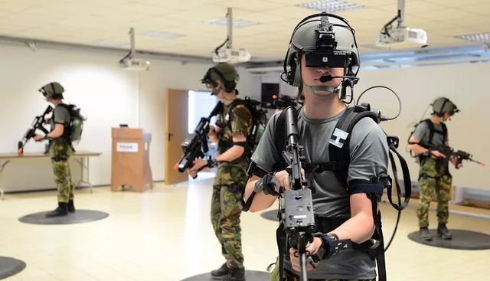
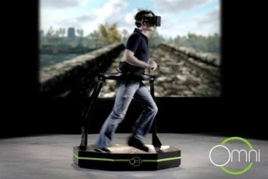
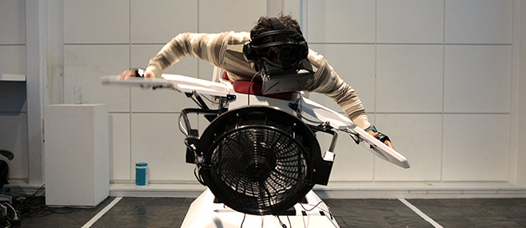
Why VR Immersion?
Notes:
Why VR? Because VR give the player very different experiences in games and it is really realistic. VR can use in a lot of industry and also some special training. Lower the training cost and the risks of the trainer.

Slide 10
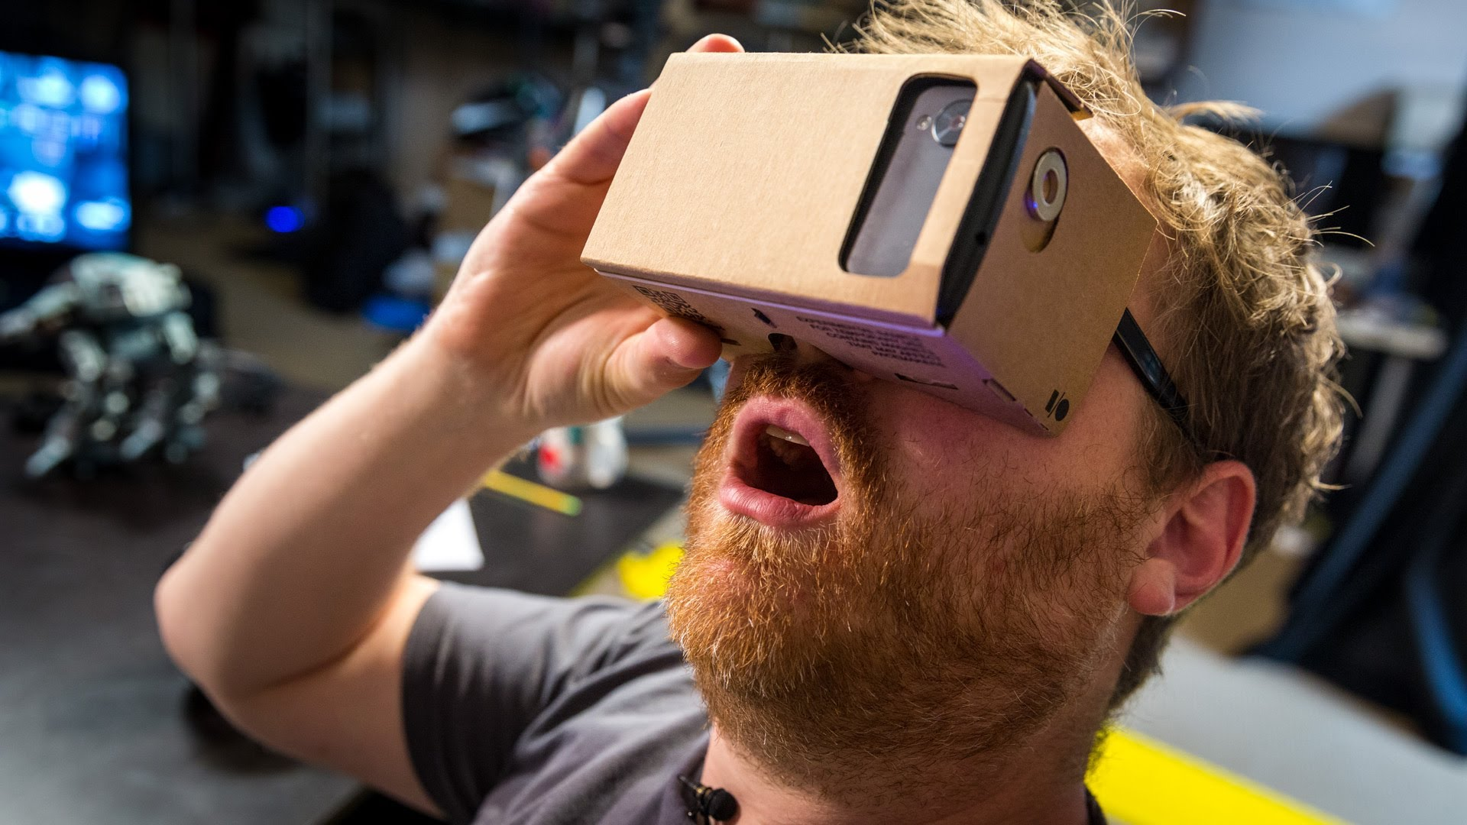
Can VR be a Daily device?
Notes:
Yes! I think so. That’s also what this game focuses on. There have many different solutions to convert the handheld devices to be VR devices. For example, Google Cardboard. As a game designer, we are responsible for lowering the cost in the future of the game market that is making everybody be able to enjoy VR with their handheld devices like a smartphone.

Slide 11
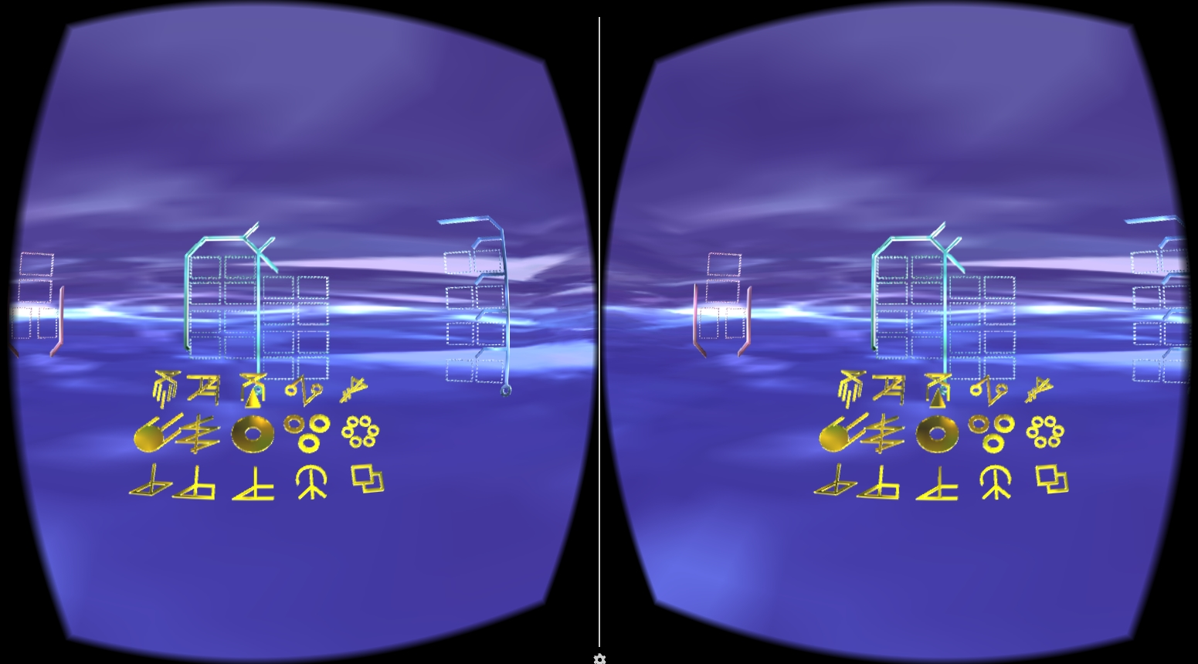
Setp1: Choose stroke to build talisman.

Slide 12
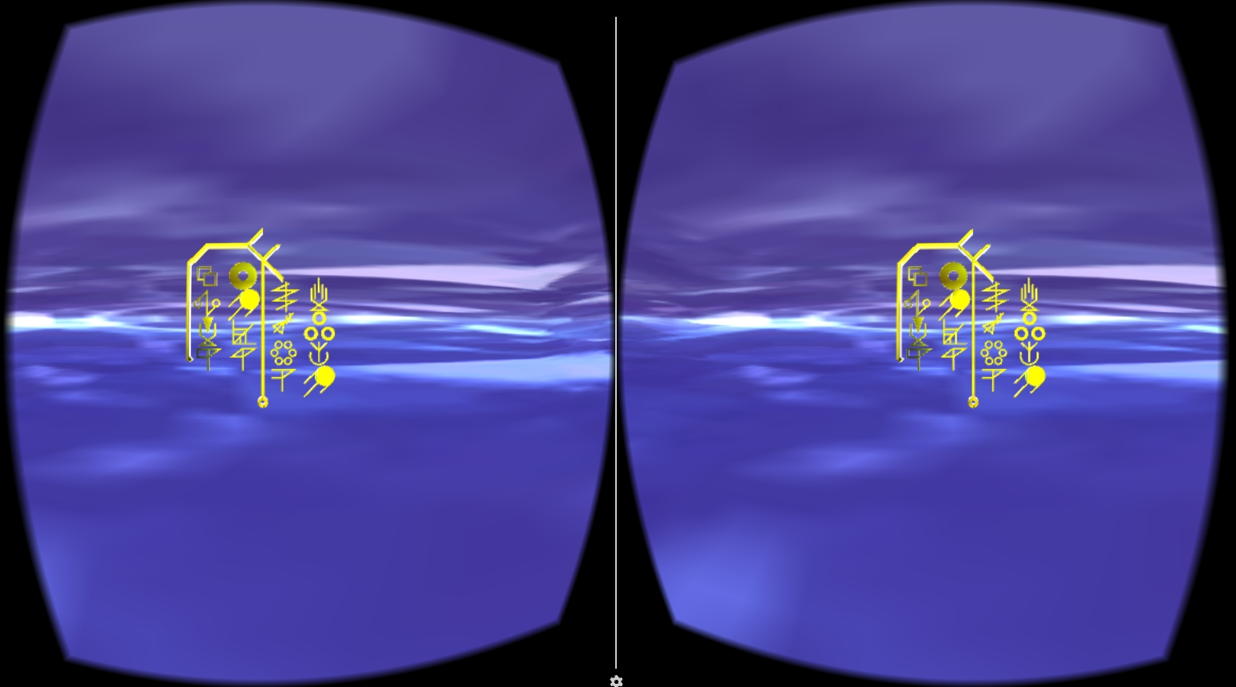
Setp2: Finalizing a talisman.

Slide 13
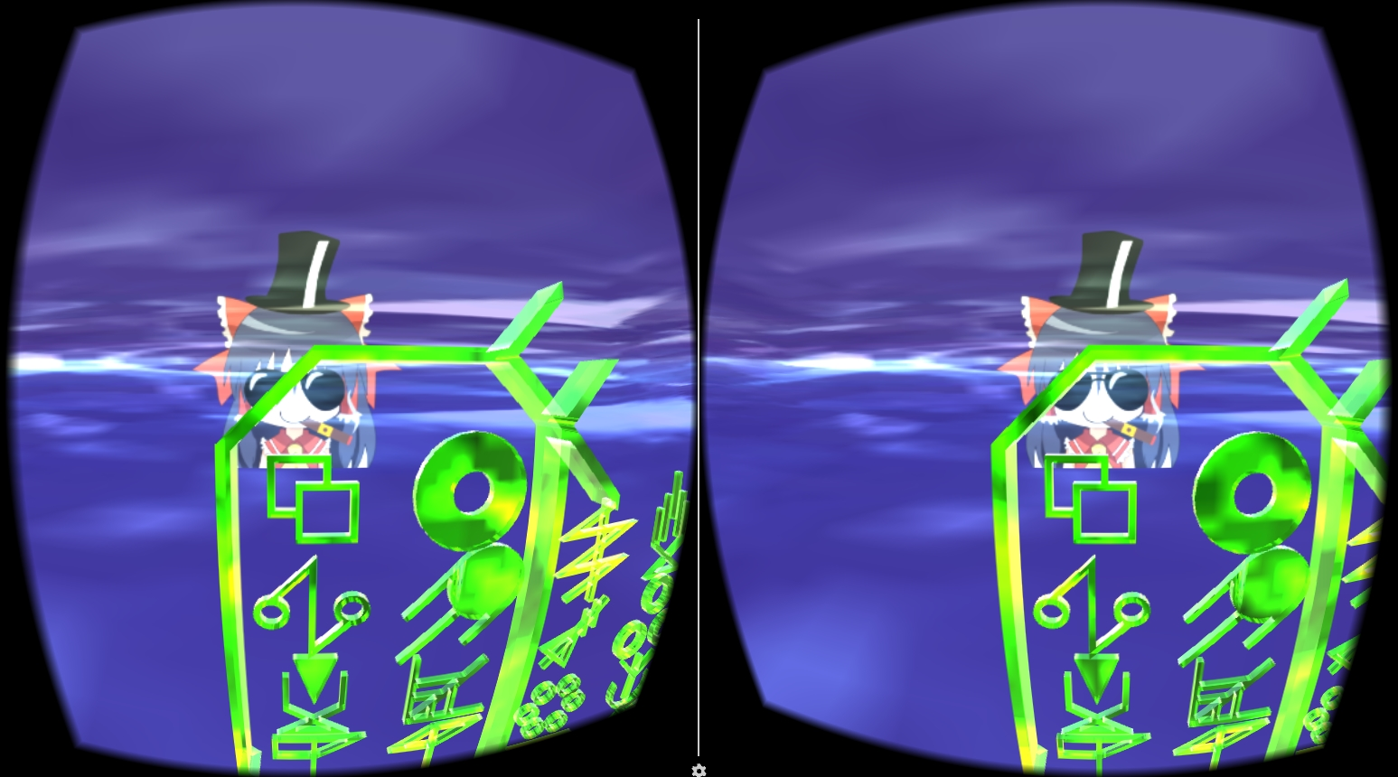
Setp3: Pick the talisman up to against the enemy!

Slide 14
Thank You! Welcome to have a Test!

